Slide 1
Molecular luminescence spectroscopy
Chemistry 243

Slide 2
Luminescence
Emission of photons accompanying the relaxation from an excited to a ground state.
Photoluminescence—Excited state generated by absorption of a photon.
Fluorescence and phosphorescence
Chemiluminescence—Chemical reaction generates excited state.
Luminescence methods have greater inherent sensitivity than absorbance and often have greater linear dynamic range.
Disadvantage is that not all molecules luminesce and matrix interferences are more significant.

Slide 3
What’s spin got to do with it?
Fluorescence involves emission from states having the same spin.
Lifetime 10⁻⁸-10⁻⁵ sec
Phosphorescence comes from “spin forbidden” transitions.
Lifetime longer than 10⁻⁵ sec
Seconds, minutes, hours
Emission maximum of fluorescence and phosphorescence typically at lower energy than excitation radiation—Stokes shift.
Exception: resonant emission (atomic fluorescence)

Slide 4
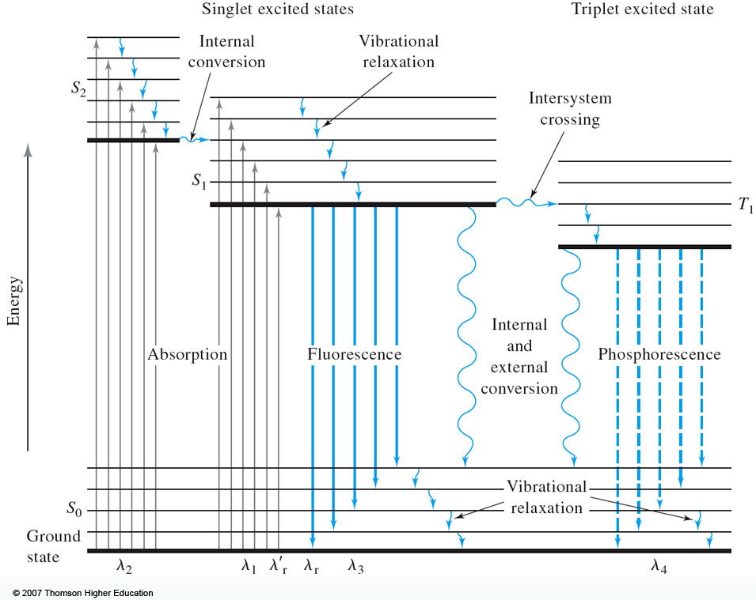
Molecular energy level diagrams aka Jablonski diagrams
λ_{fluorescence} > λ_{absorbance}
λ_{phosphorescence} > λ_{fluorescence}

Slide 5
Quantum yield
A metric that describes efficiency of the fluorescent or phosphorescent process.
Approaches 1 for highly luminescent molecules
0 for non-luminescent molecules
Ratio of the number of luminescent molecules compared to the total number excited.
Consider all deactivation pathways
k_{f} = fluorescent rate constant
k_{i} = intersystem crossing rate constant
k_{ec} = external conversion rate constant
k_{ic} = internal conversion rate constant
k_{pd} = predissociation rate constant
k_{d} = dissocation rate constant

Slide 6
Transition type and effects on fluorescence and phosphorescence
σ*-σ transitions rarely result in luminescence
Too high of energy (λ < 250 nm) leads to predissociation and dissociation
Emission more common from π*-π, but also π*-n
From the lowest excited state
π*-π usually has greater quantum efficiency
Greater molar absorptivity of π-π* (10-100x) means high transition probability—short lifetime leads to large k_{f}

Slide 7
Structural considerations
Fluorescence common in aromatic compounds with low-energy π*- π transitions
Conjugation shifts emission to red and greatly increases φ
Example: pyridine vs. quinoline
Sensitive to substituents
Wavelengths of maximum absorption and emission and quantum yield
Halogens lead to sharp decreases in φ
Heavy atom effect promotes intersystem crossing via spin-orbit coupling
Electronegativity also can give easily broken bonds
Structural rigidity enhances fluorescence
Lack of rigidity promotes non-radiative decay pathways (k_{ic})
Example: Fluorene vs. biphenyl
vs.

Slide 8
Environmental effects on fluorescence
Temperature
Increased number of collisions promotes external conversion.
Solvent
Heavy atoms in solvent promote intersystem crossing.
pH
Differing protonation states lead to resonance structures that change excited state energies
Concentration
When too many chromophores, the radiant power decreases through the sample so that not all species have chance to absorb and thus emit.

Slide 9
Quenching of fluorescence and phosphorescence
Nonradiative energy transfer from excited states to other molecules.
Dynamic (collisional) quenching—external conversion
Collision of excited species and quencher dependent on diffusion
Temperature, viscosity, and quencher concentration-dependent
Dissolved O₂ is efficient quencher—degas solutions
Static quenching: quencher complexes with ground state fluorophore to form ‘dark complex’
Förster quenching
Not dependent on collisions—long-range effect
Dipole-dipole coupling—falls off as 1/(distance)⁶
Basis for Fluorescence Resonance Energy Transfer (FRET)

Slide 10
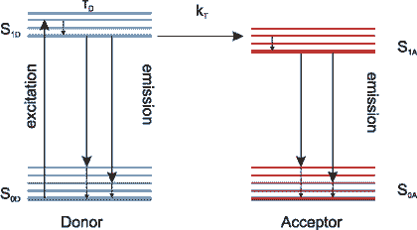
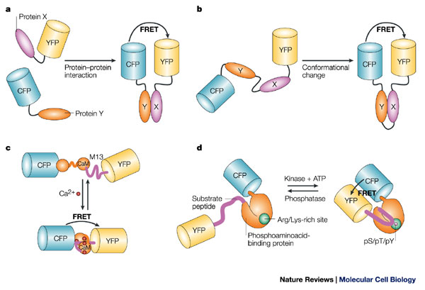
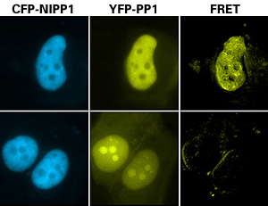
FRET microscopy
Wild type
Mutant
Nature Rev. Molec. Cell Biol., 2002, 3, 906-918.
http://upload.wikimedia.org/wikipedia/commons/3/3a/FRET.PNG
http://www.bphys.uni-linz.ac.at/bioph/res/icg/Bilder/fret_methJD.png
http://www.moleculardevices.com/pages/MM-new/metamorph_applications.html

Slide 11
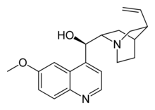
Excitation and emission spectra
A
B
B
quinine
C
A
C
D
D

Slide 12
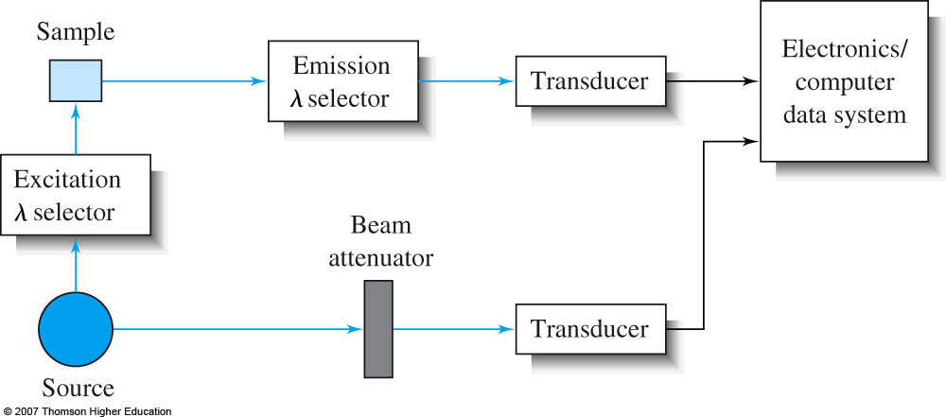
Instrumentation for fluorescence and phosphorescence
Almost always are double-beam
To compensate for radiant power fluctuations
Right angle detection
Why?
Why?

Slide 13
Components of fluorometers and spectrofluorometers
Sources
Most common: Low-pressure Hg vapor lamps
254, 302, 313, 546, 578, 691, and 773 nm lines
High-pressure Xe lamps
Continuum from 300-1300 nm
Lasers: essential for research operation with small samples, remote sensing (collimation), and when highly monochromatic light needed
Wavelength selectors
Interference filters or absorption filters for fluorometers
Grating monochromators (usually two) in spectrofluorometers
Transducers
PMTs often used for high sensitivity and often cooled to reduce S/N
CCDs for multichannel data acquisition

Slide 14
Fluorometer

Slide 15
Spectrofluorometer

Slide 16
Correction of source and transducer variations with wavelength
Sources don’t have uniform power at all wavelengths which can bias excitation and emission spectra.
Most instruments have a reference spectrum stored in computer memory that can be used for instrumental correction.

Slide 17
Pros and cons of photo-luminescent analytical methods
Photoluminescence methods are inherently more sensitive than absorbance-based measurements
Fluorescence and phosphorescence dependent upon incident power, but measured independently of P₀.
Absorbance requires measurement of P and P₀—cannot be measured independently.
Also gives greater dynamic range because power can be modulated accordingly.
Typically give linear calibration plots and have high selectivity.
Photoluminescent measurements have less precision and accuracy.
Flicker noise and drift of source.
Background fluorescence, scatter, or quenching by matrix.

Slide 18
Applications of photoluminescence
Inorganic species determination
Formation of fluorescent complex via chelation
Fluorescence quenching—most common
Organic and biochemical species via fluorescence
Valuable tool to characterize foods, pharmaceuticals, clinical samples and natural products
Phosphorimetric methods
Complementary to fluorescent methods
Highly phosphorescent molecules often have weak fluorescence and vice versa.
Potentially greater selectivity because triplet conversion is required, but more difficult measurement (collisional quenching at RT problem with longer lifetimes)
Laser-induced fluorescence for detection in liquid chromatography

Slide 19
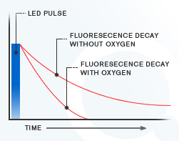
Fluorescent lifetime measurements
Fluorecence lifetime gives added element of selectivity
Reports on collisional deactivation and energy transfer rates proximal to the fluorophore.
10 microsecond to sub-nanosecond time scale
http://www.olympusfluoview.com/applications/flimintro.html
http://www.oxysense.com/technology/article/how_it_works/

Slide 20
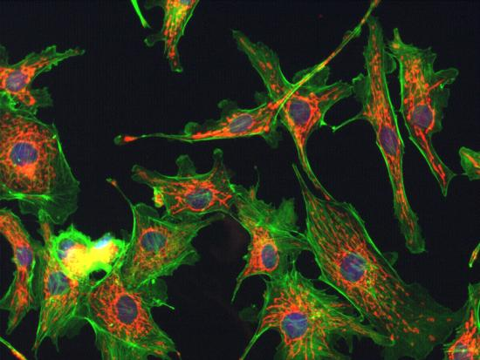
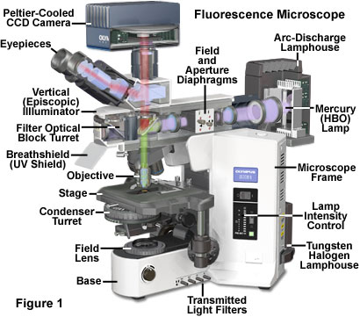
Fluorescence microscopy
Subcellular fluorescence imaging
Combined with recombinantly-expressed fluorophores (GFP, etc.—Roger Tsien) has revolutionized biology.
http://micro.magnet.fsu.edu/primer/techniques/fluorescence/anatomy/fluoromicroanatomy.html
http://www.rp-photonics.com/img/kahn_fl_image.jpg

Slide 21
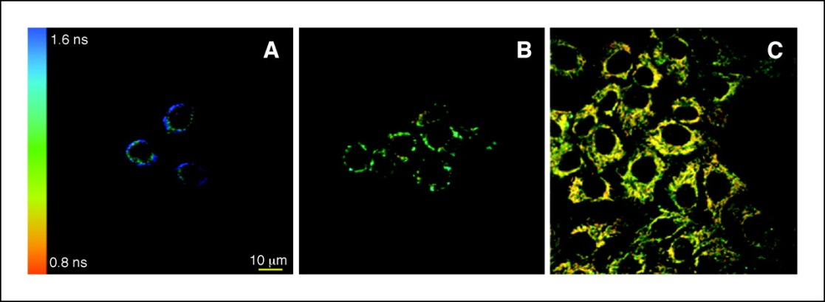
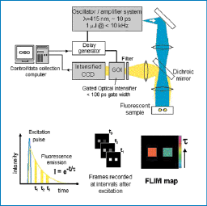
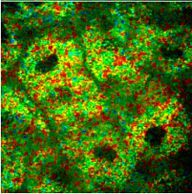
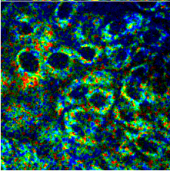
Fluorescence lifetime imaging (FLIM)
Normal
Severe Dysplasia
Cancer Research, 2005, 65, 8766-8773.
http://nimmi.bme.duke.edu/flim.html
1.4ns
2.4ns

Slide 22
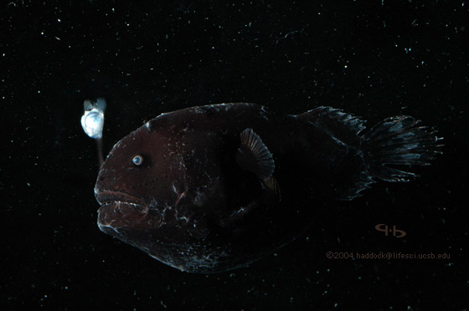
Chemiluminescence
Excited state that emits light generated via a chemical reaction.
Actual mechanism usually quite complicated
Bioluminescence
Firefly, sea pansy, jellyfish, etc.
A + B → C* + D
C* → C + hν
http://www.lifesci.ucsb.edu/~biolum/organism/photo.html

Slide 23
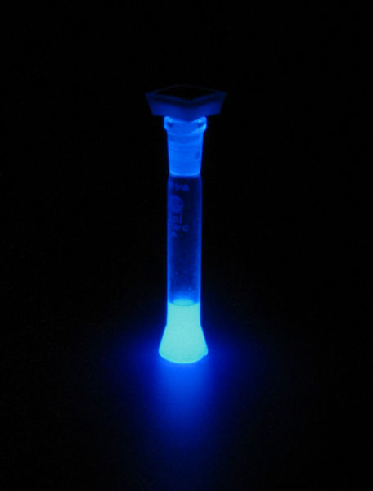
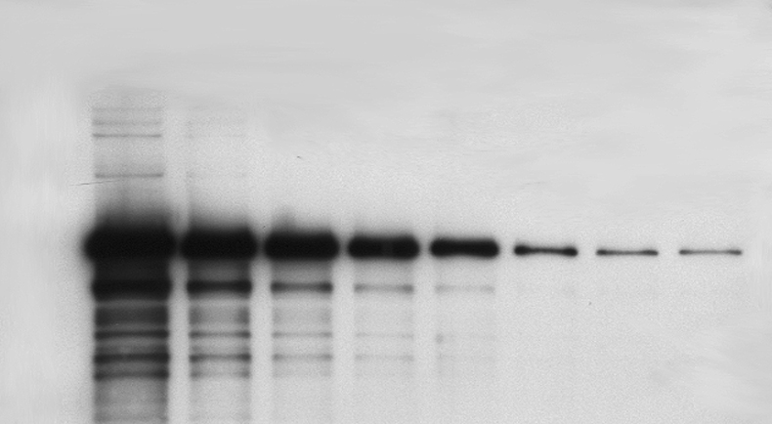
Analytical applications of chemiluminescence
Typically highly sensitive because there is no other source of light noise
“Zero background” measurement
Very simple instrumentation
No wavelength selection is typically needed
Signal intensity monitored over time
Analysis of gases
Nitric oxides: NO and NO₂ via reaction with O₃
Analysis of strong oxidants or species that can generate strong oxidants (enzymatically).
Luminol: 5-Amino-2,3-dihydro-1,4-phthalazinedione
http://en.wikipedia.org/wiki/Luminol
http://www.kpl.com/images/WESTERN2.JPG

